Slide 1

ECE 3300/3300L Group D: Group Project
By: Alex Beckes, Foad Naeimi, Ignacio Velasco

Slide 2
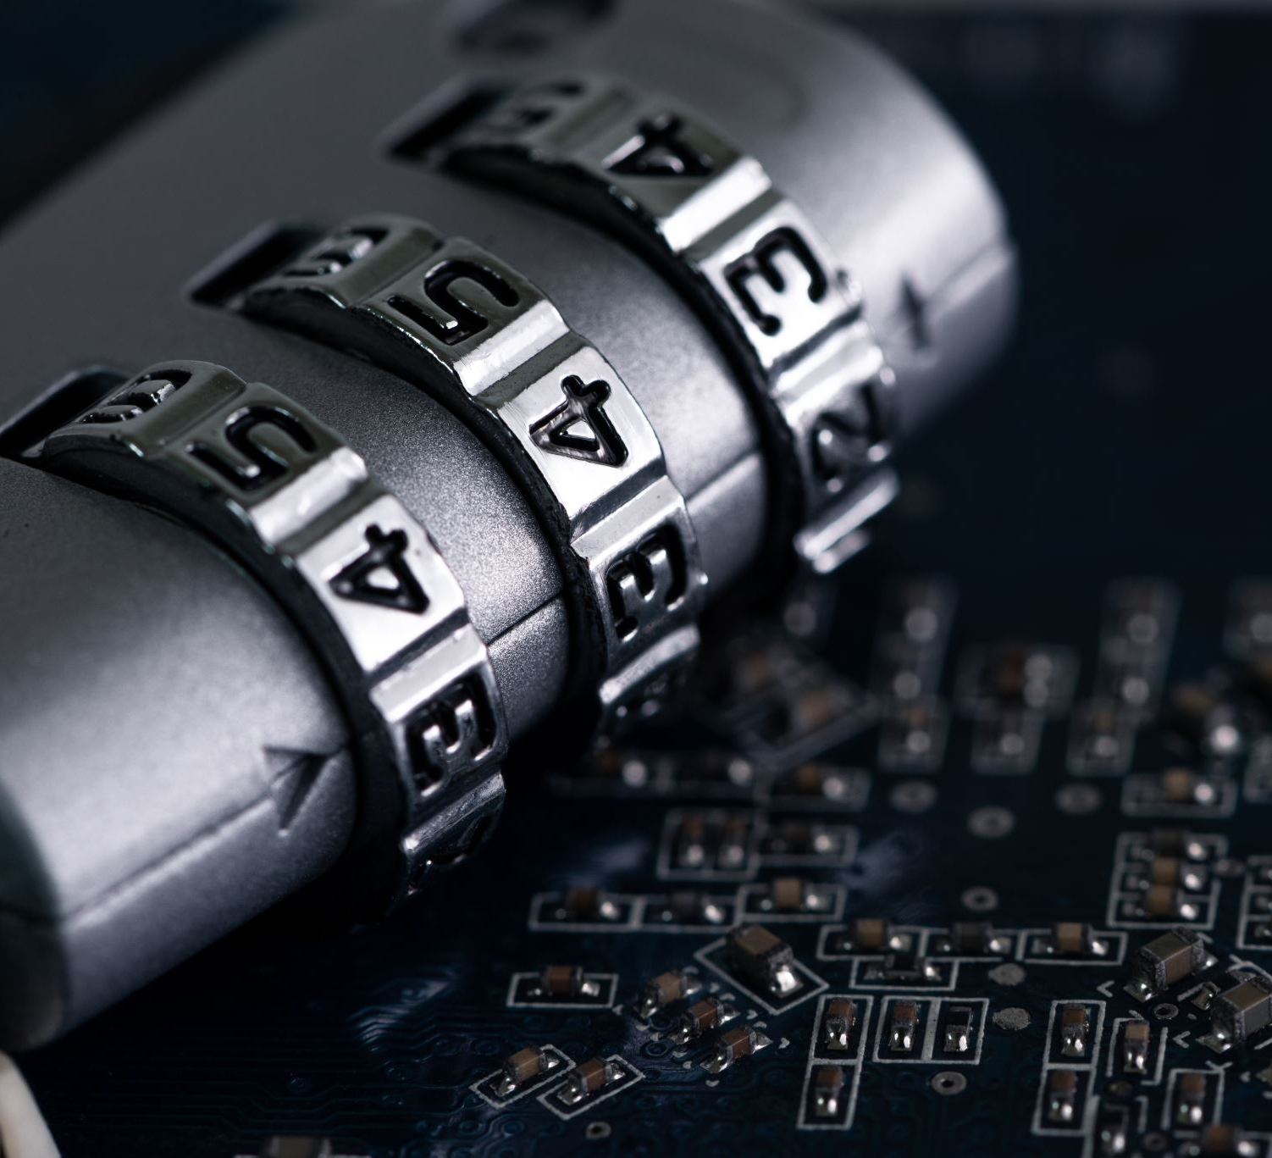
What is Our Project?
Password Encryption/Protection
Self Developed Encrypted password language

Slide 3
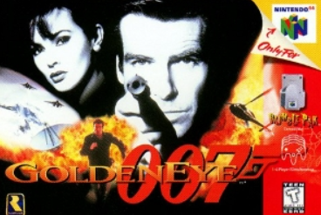
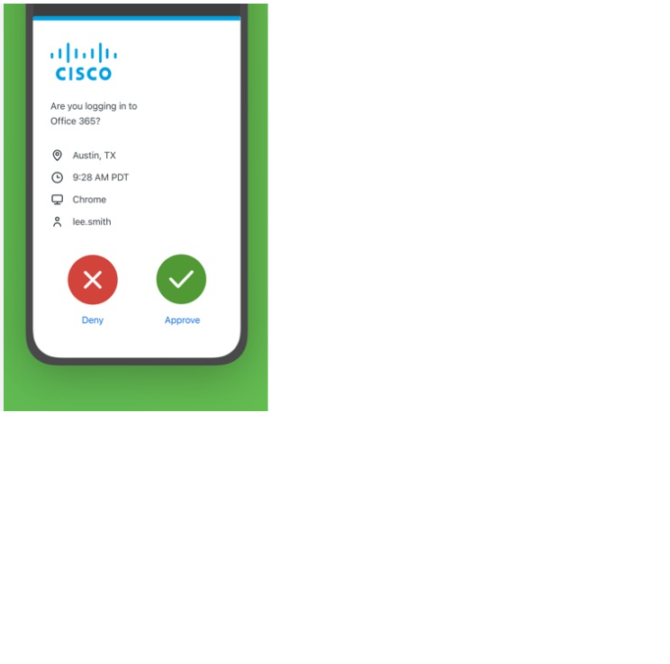
Where Did this idea come from?
The idea for this project arose from wanting to do some kind of encryption, that shouldn’t be based on any existing encryption.
It also stems from our experiences using two step authenticators such as DUO mobile.
Drew Inspiration From outside media such as video games and movies
Spies Exist and although it may not be like in the movies, its very important to protect what you can from unwanted users.

Slide 4

What Was Implemented In This Project?
The Group implemented the following requirements into their project
Buttons
Switches
7-Segment Displays
PMOD (LCD Connected)
UART (possibly)

Slide 5
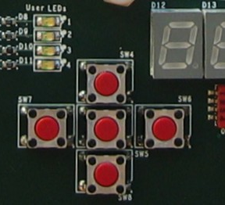
Buttons (Reset/Load)
Two buttons were used for this project.
One button functions as a password set
Another button works to reset the whole system.

Slide 6
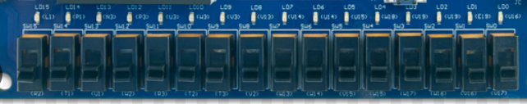
Switches (Input)
The switches serve dual functionality in our project
Set Password
Code will generate a random code and then we can set it.
Enter Password
With the use of the LCD screen the user will be able to know what the password is.

Slide 7
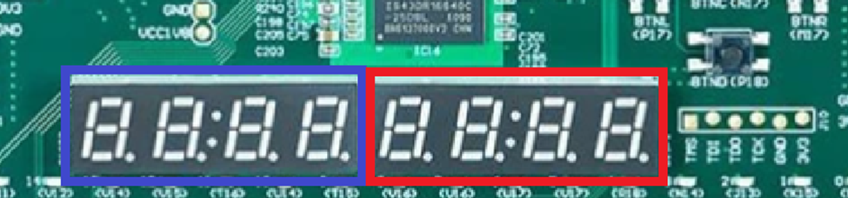
7-Segment Displays
The password is displayed (albeit encrypted) on the four displays and the password is entered on the other four
The left 4 are used as our FPGA input’s output
The right 4 are used to hold the Password set by the team

Slide 8

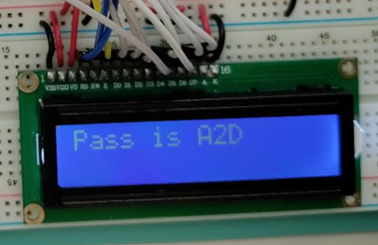
PMOD(LCD)
The Lcd served as a authenticator that Allowed the appropriate users password info.

Slide 9
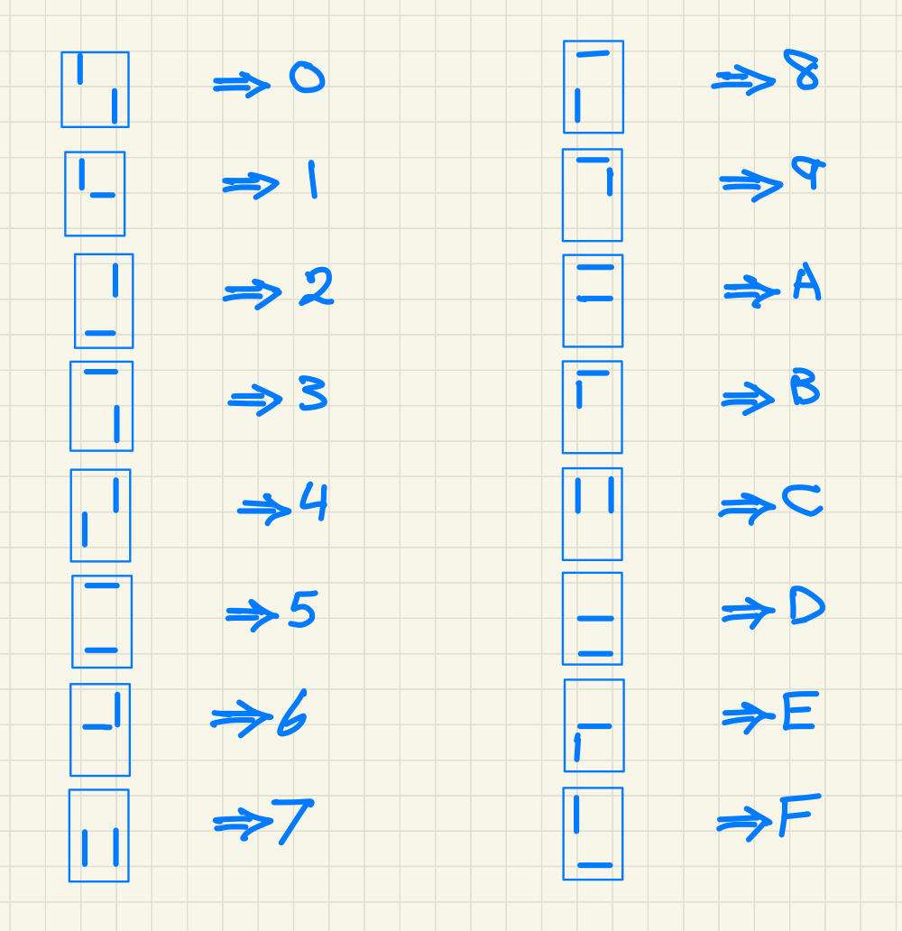
Encrypted Alphabet Used
The symbols/alphabet we used was developed by Foad.

Slide 10
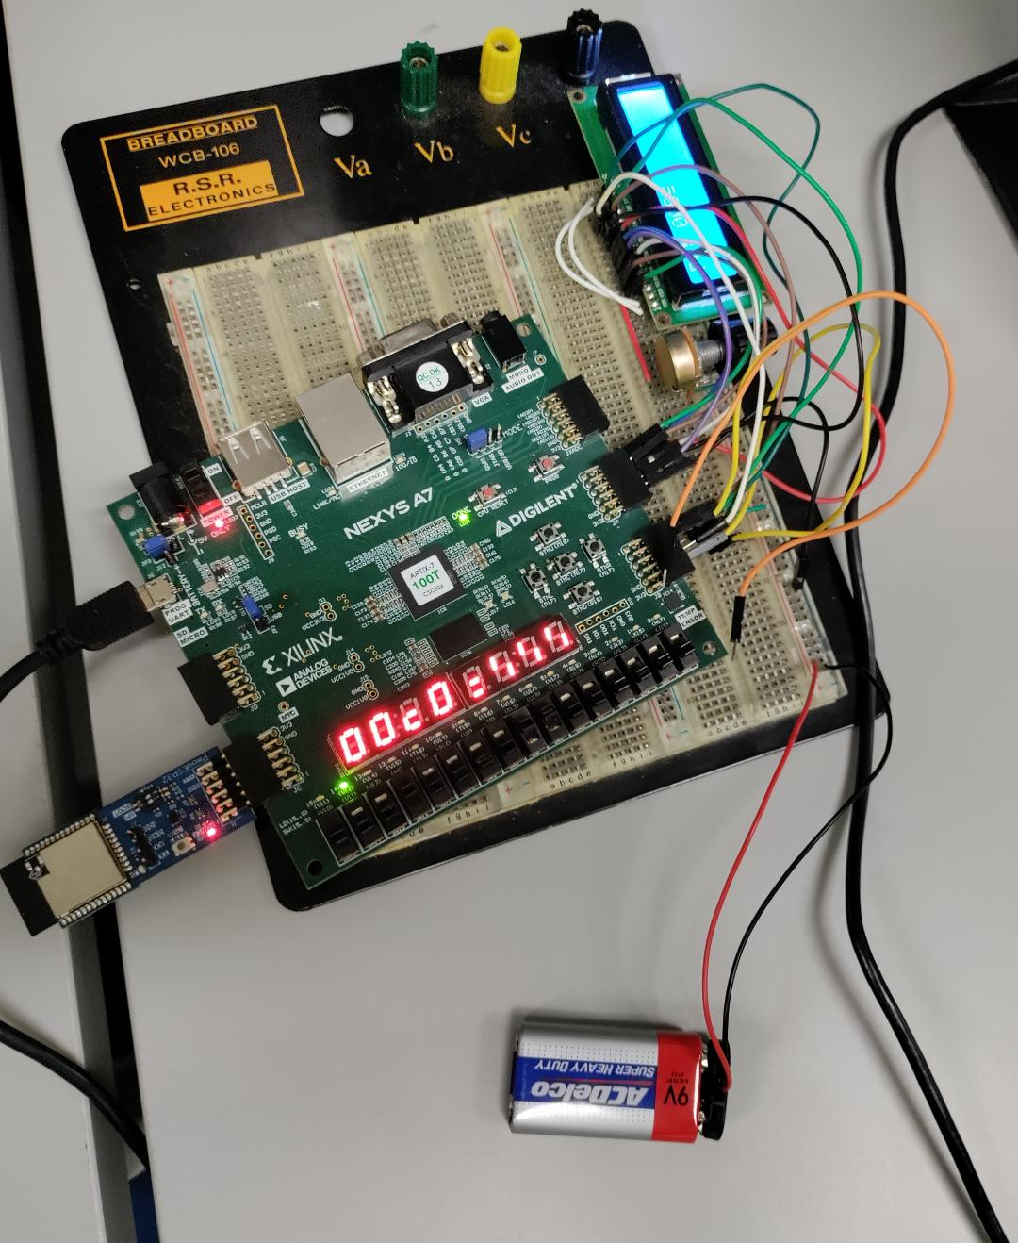
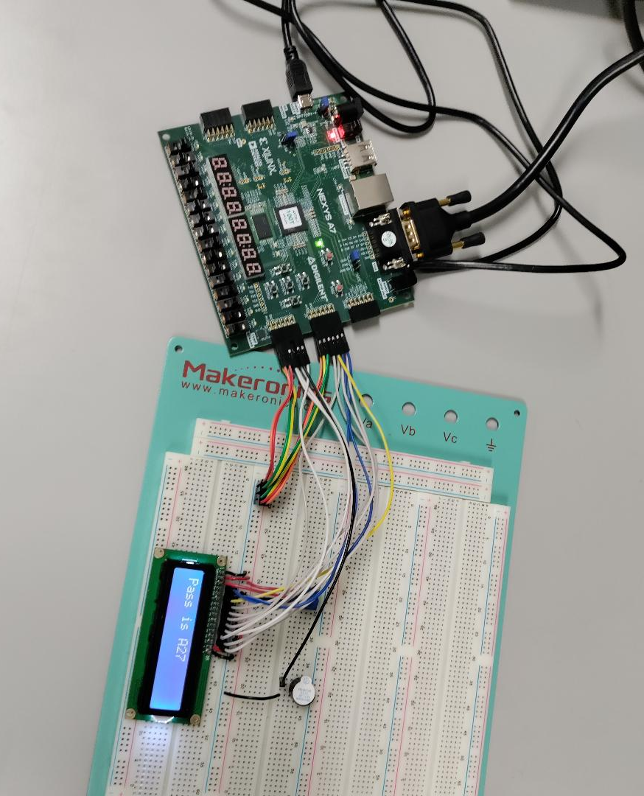
Project Circuit(s)
These are the circuits developed by the team members
Alex on the left-hand side
Foad on the right-hand side

Slide 11
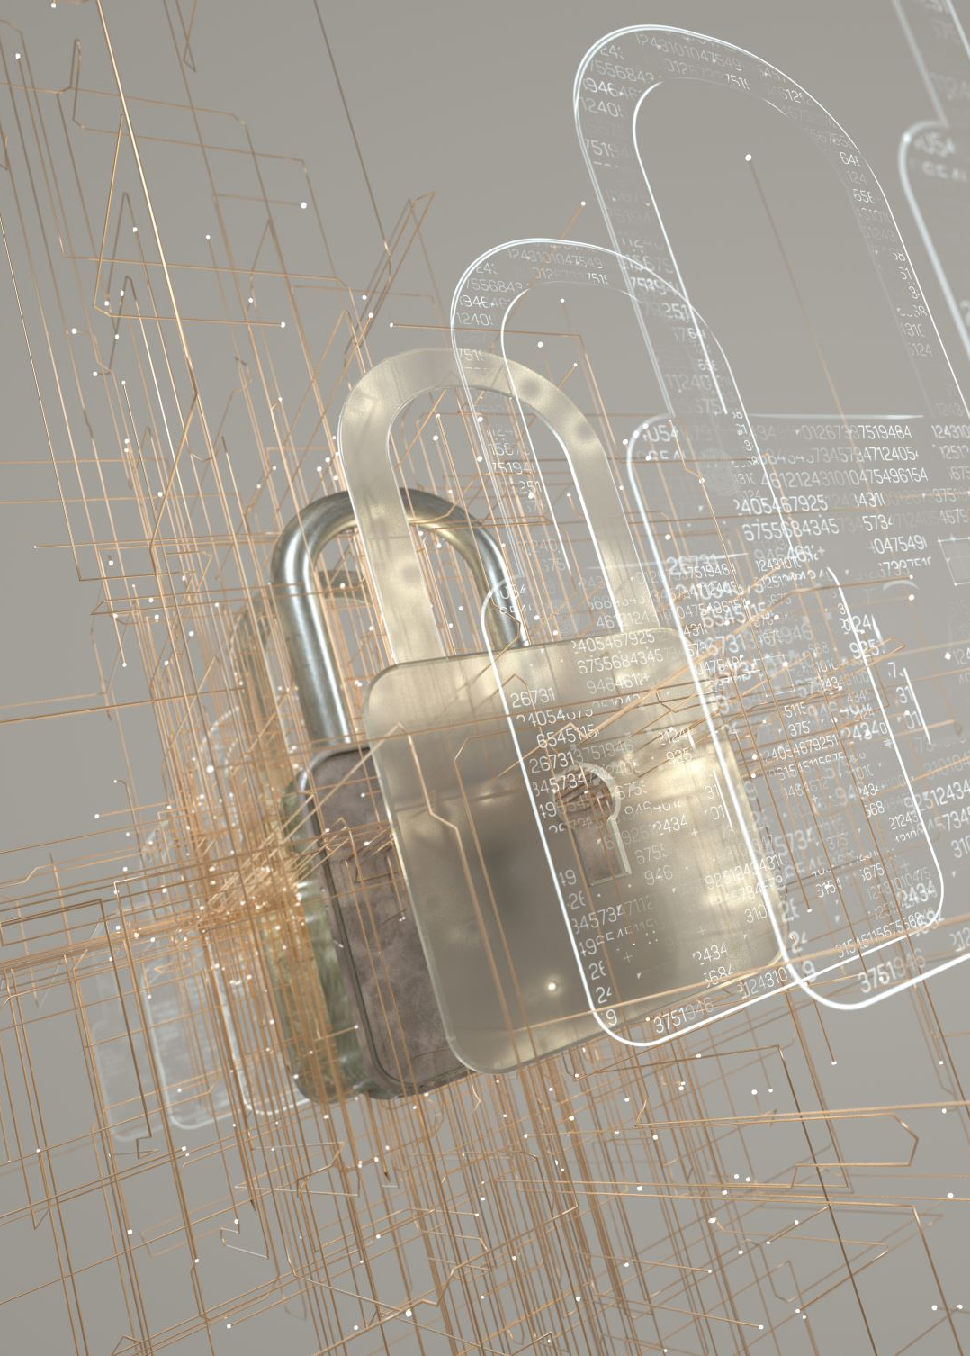
Conclusion
This project is just a small step into the introduction of two step factoring, encryption and much more topics about security.
The implementation of the UART seemed a bit difficult so sadly it was not implemented in this lab
UART would have been a wireless connection to a keyboard for password entry

